Slide 1
Porsche EV Marketing Analytics
Customer Zipcode Attention Recommendation (CZAR)
Sanjay Jain - srajkumarjain1@student.gsu.edu
Shashank Goswami - sgoswami7@student.gsu.edu
Jennifer S. Johnson - jstanjohn@gmail.com
Patrick Hackett - patrick.d.hackett@gmail.com
Phase 2 Submission

Slide 2
Model Benefits
Marketing Recommendation model delivers business ready geographical drilldowns on optimized marketing targets segmented by consumer profile that can immediately be used in marketing strategy.
A simulated wait time model provides a heat map of prioritized charging station locations based on consumer need as well as a weighted version to coincide marketing strategy for greatest ROI.
Models allow for continuous improvement, allowing Porsche to improve its regional predictions over time.
Clusters are segmented along PCA orthogonal vectors to allow most robust segmentation.
Simulation can integrate Bayesian updating with new data.
Heatmaps can be trained and tuned in conjunction with new marketing data to ensure greatest ROI of marketing campaigns.
The end-to-end model uses columnar data, machine learning models in python, and integrated live Tableau dashboard deliverables, so is easy to implement and can scale quickly based on data availability.

Slide 3
Q1 Optimized Charging Station Locations

Slide 4
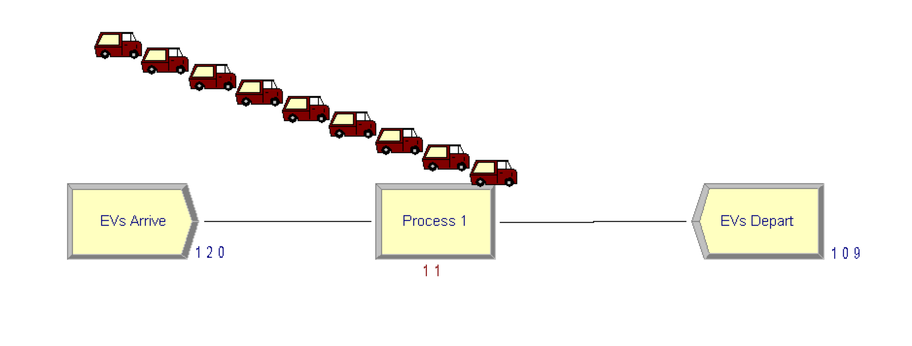
Simulated Customer Wait Times
Simulated wait times at charging locations over a five-hour period based on Chargepoint API data
Ran simulations using SimPy and replicated in Arena to visualize long queue
Created charging stations; EVs modeled with exponential interarrival times
Wait times range from 0 to 122.215 minutes
Simulation is easily scalable as more charger location data become available
EV Charging Simulation

Slide 5
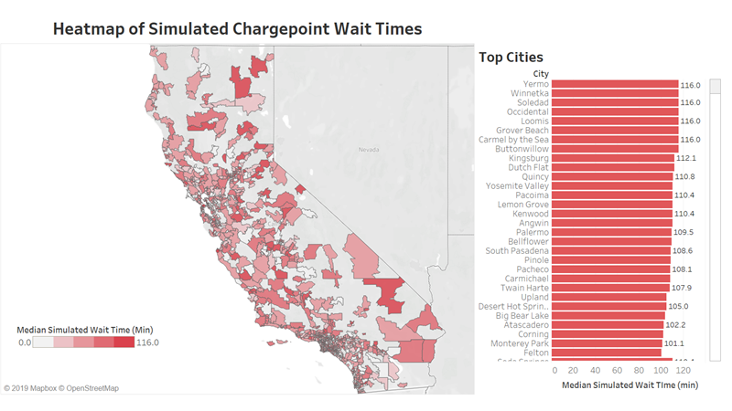
Notes:
Tableau dashboard, live connection to the data.
Drilldowns possible.
Fully productionalizable to the cloud on on-prem enterprise data systems.

Slide 6
Q1 Technical Explanation
Using Python and Arena, simulated wait times at EV charging locations (by zip code) using exponential interarrival of EVs and publicly available Chargepoint network data.
Normalize charging times across Levels 1-3 chargers to account for differences in charging rates and to find the equivalent number of total chargers (NUM_CHARGERS).
Set charge time as a random variable on the range of 30 to 120 minutes.
Set up and start the simulation.
Create charging locations, initial EVs, and arranged for additional EVs with exponential interarrival times in minutes.
EV arrives at the charging location and requests a charger.
Begin the charging process (in parallel if NUM_CHARGERS > 0), waits for it to finish, and leaves the charging location.
Simulated wait times are used to provide suggested Chargepoint build numbers/zipcode on a heat map.
This technical solution is easily scalable as actual wait times and charger location data are made available and/or updated.

Slide 7
Q2 Customer Clustering Model and Segmentation into Marketing Personas

Slide 8
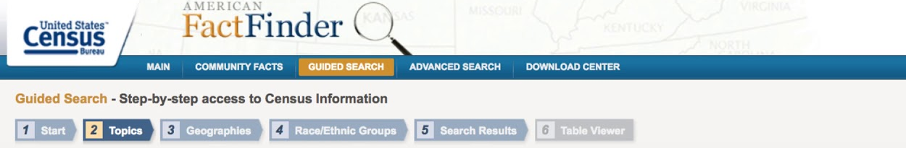


Data Sources
Aim was to build an end to end model so collected exhaustive data of California.
ZIP code was the primary key for augmentation of all the data sets.

Slide 9






Main Factors in the Augmented Demography
Dataset
INCOME
E.V CHARGERS
EDUCATION LEVEL
CARS
HOUSING
OCCUPATION

Slide 10
INCOME
EDUCATION
CARS
HOUSING
ABOVE 100K$
BETWEEN
75 - 100K$
BETWEEN
45 - 75K$
LESS THAN
45K$
UNDERGRADUATES BETWEEN 18-25 YEARS OF AGE. (MALE AND FEMALE)
HIGH - SCHOOL BETWEEN 18 - 25 YEARS OF AGE. (MALE AND FEMALE)
MASTERS BETWEEN 18 - 25 YEARS OF AGE.
(MALE AND FEMALE)
UNDERGRADUATES ABOVE 25 YEARS
.
.
.
14) DIPLOMA ABOVE 25 YEARS (MALE AND FEMALE)
GASOLINE CARS BETWEEN 0 - 20K $
DIESEL CARS BETWEEN 40-70K $
E.V CARS BETWEEN 70-100K $
HYBRID CARS ABOVE 100K $
.
.
.
40) OTHERS ABOVE 100K $
HOUSING - 1 UNIT
.
.
5) HOUSING - 9 UNITS +
6) HOME VALUE - 50 - 150K$
.
.
10) HOME VALUE ABOVE 100K$
11) RENT VALUE - 500 - 1000$
.
.
14) RENT VALUE ABOVE 2K $

Slide 11
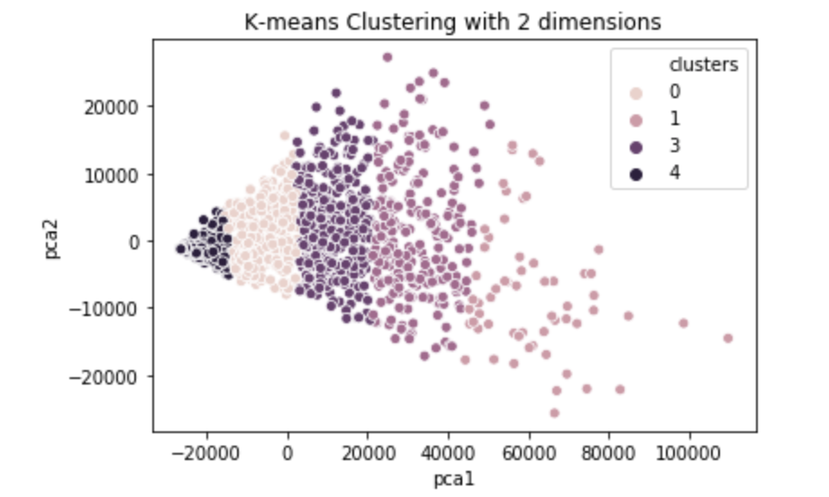
Clustering
Applied K-means Clustering , chose the optimal number of clusters by using Elbow Method.

Slide 12
Cluster Analysis
Data Standardization - For each and every feature (Housing,Income,Education,Cars) population proportion of the respective sub-features by each ZIP code was calculated.
Example: Feature is Income and sub_features are the incomes at different levels.
-

Slide 13
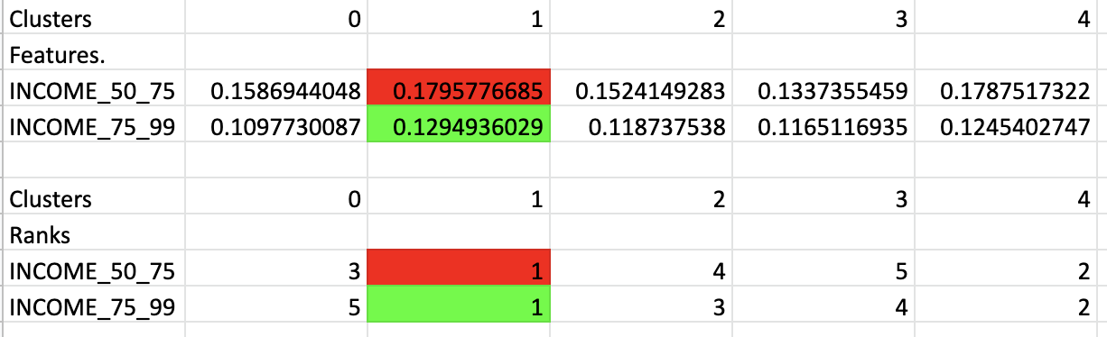
Cluster Analysis - 2
In a cluster, average of all the features at zip code level was taken.
Each features average value at cluster level was compared with the other clusters and rank was given.

Slide 14


Customer Segmentation
Customer Segmentation
Customer Segments | Stalwarts | Risk Takers | Non Buyers | Upwardly Mobile | Pragmatists
Cluster | 0 | 1 | 2 | 3 | 4
Gender | male | -- | -- | female | female
Highest Education Level | Associate Degree | High School | -- | Master’s Degree | Some college
EV Types within Cluster | Battery Electric Plug-in Hybrid | Battery Electric | none | Battery Electric Plug-in Hybrid | Battery Electric Plug-in Hybrid
Top Vehicle Price | $40k | $100k | $30k | $100k | $30k
Income | $0 - $49k | $ 50k - $99k | -- | $100k+ | --
Occupation | construction maintenance | sales transportation | -- | arts | service
Housing | homeowner | homeowner; owns 3 vehicles | -- | mix of homeowners & tenants; owns 1-2 vehicles | mix of homeowners & tenants
Home Value/ Rent | $50k - $150k | -- | -- | $500k - $1M/ $1500+ | $150k - $500k/ $500 - $1500

Slide 15
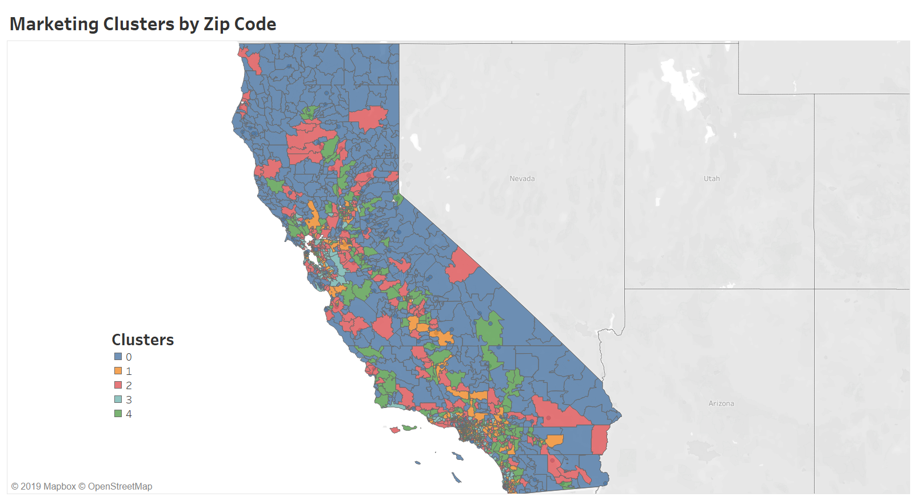

Slide 16
Q3 Marketing Recommendations: Recommended dollar spent per zipcode provided based on user-inputted EV type and cost

Slide 17
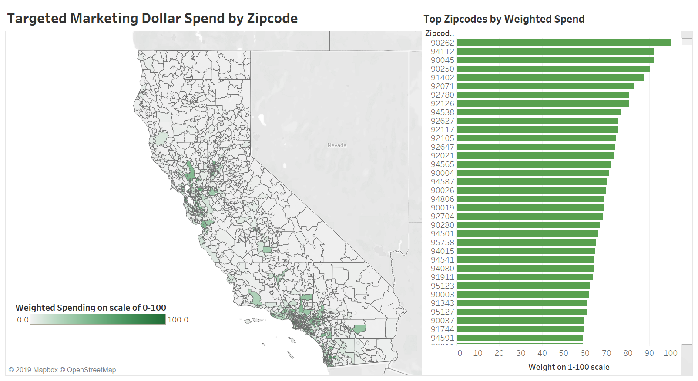

Slide 18
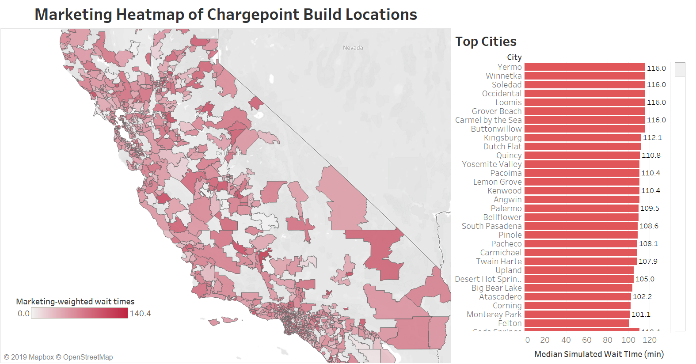

Slide 19
Q3 Technical Explanation
Taking an inputted Porsche car profile, a weighted marketing dollars suggestion towards each cluster is provided on a live heatmap.
Weighting is based on cluster output and proportion of each car type and price range owned out of total cars owned in each zipcode, a per-cluster weighting of inputted.
Weights can be varied via linear regression of coefficient of different demographic values and how they influence likelihood to purchase targeted vehicle.

Slide 20
Future Steps
Deliver Model to Production system and Workbooks to business users, end-to-end POC is provided.
Ingest data into cloud or on-prem server.
Run python script in Databricks to deliver clustering results to tables on the cloud server.
Use a live connection of the data to Tableau.
Business stakeholders can use live Tableau workbooks to plan marketing decisions
Continuously iterate, tune, and improve model.

Slide 21
Thank you!

